Slide 1
Advanced pharmaceutical analysis mass spectrometry 5 stage lect.4

Slide 2
Amines Aliphatic Amines • M⁺ will be an odd number for monoamine; may be weak/absent • M-1 common • α-cleavage of an alkyl radical is predominate fragmentation mode largest group lost preferentially • McLafferty rearrangement / loss of NH3 (M-17) are not common

Slide 3
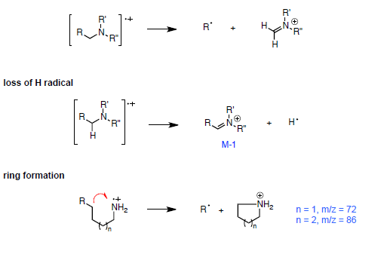
Amines fragmentation patterns * α-cleavage

Slide 4
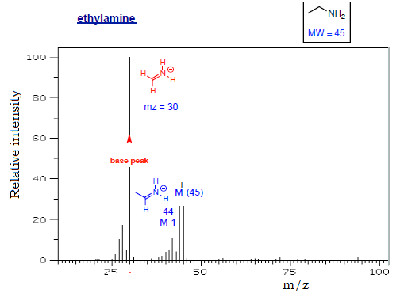

Slide 5
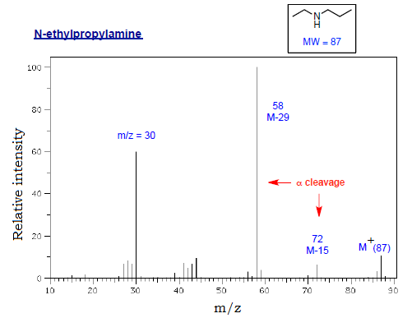

Slide 6
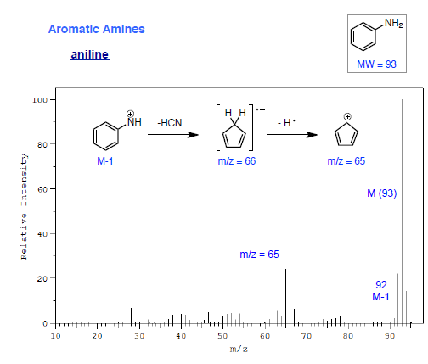
Aromatic Amines • M⁺ usually strong • M-1 common • loss of HCN is common in anilines.

Slide 7
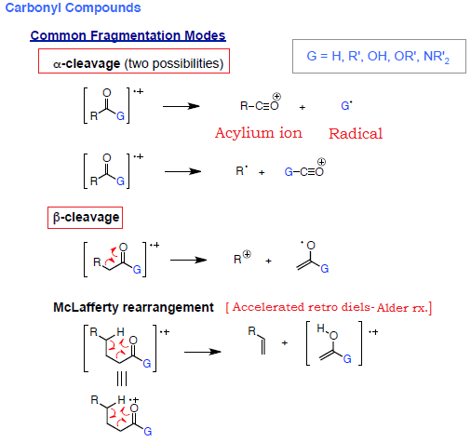

Slide 8
Aldehydes • M⁺ may be weak in aliphatic aldehydes • M-1 common (α-cleavage) • α-cleavage is predominant fragmentation mode; often diagnostic (m/z = 29)especially in aromatic aldehydes (M-1; M-29) • β-cleavage results in M-41 fragment; greater if α-substitution • McLafferty rearrangement in appropriately substituted systems (m/z = 44 or higher)

Slide 9
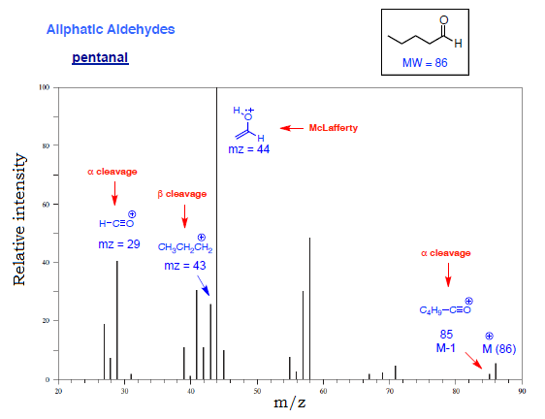

Slide 10
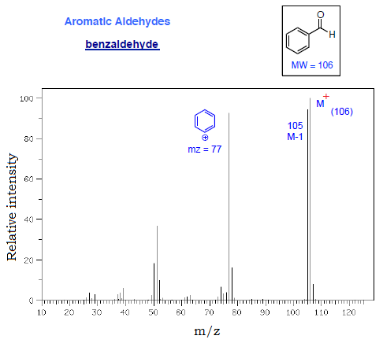

Slide 11
Ketones • M⁺ strong • α-cleavage is the primary mode of fragmentation • β-cleavage less common, but sometimes observed • McLafferty rearrangement possible on both sides of carbonyl if chains sufficiently long • Cyclic ketones show complex fragmentation. • Aromatic ketones primarily lose R• upon α-cleavage, followed by loss of CO

Slide 12
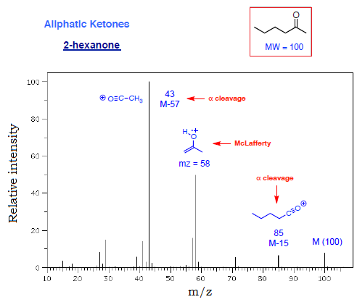

Slide 13
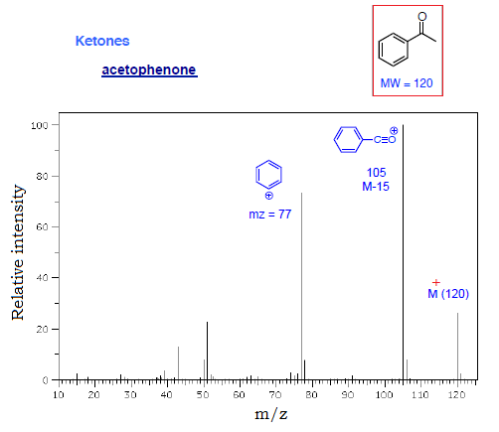

Slide 14
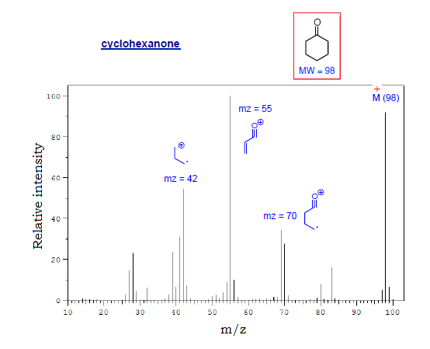

Slide 16
Carboxylic Acids • M⁺ weak in aliphatic acids; stronger in aromatic acids • Most important α-cleavage involves loss of OH radical (M-17) • α-cleavage with loss of alkyl radical less common; somewhat diagnostic (m/z = 45) • McLafferty rearrangement in appropriately substituted systems (m/z = 60 or higher) • Dehydration can occur in o-alkyl benzoic acids (M-18)

Slide 17
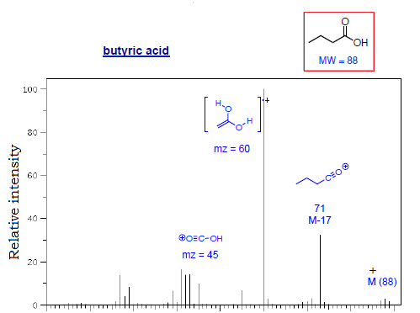

Slide 18
Esters • M⁺ weak in most cases; aromatic esters give a stronger parent ion • Loss of alkoxy radical more important of the α-cleavage reactions • Loss of an alkyl radical by α-cleavage occurs mostly in methyl esters (m/z = 59) • McLafferty rearrangements are possible on both alkyl and alkoxy sides • Benzyloxy esters and o-alkyl benzoates fragment to lose ketene and alcohol, respectively

Slide 19
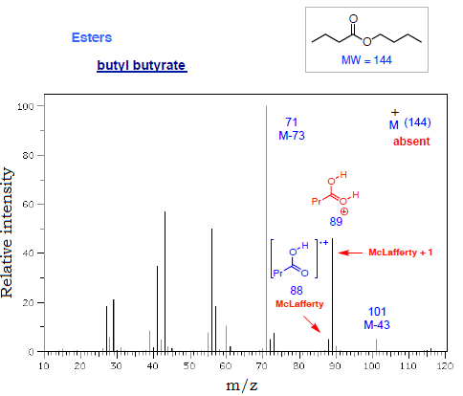

Slide 20
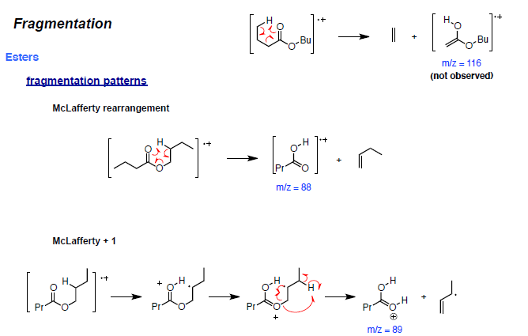

Slide 21
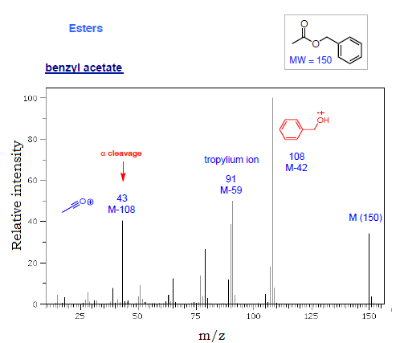

Slide 22
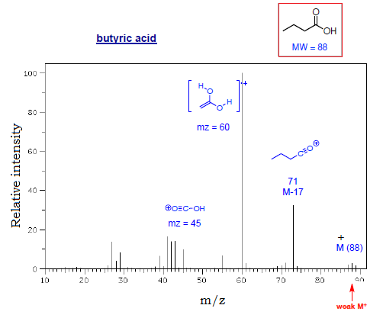

Slide 23
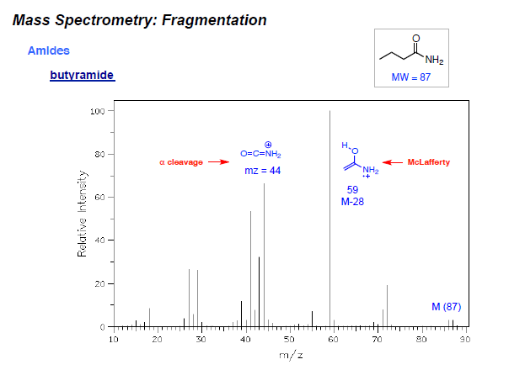
Amides • α-cleavage affords a specific ion for primary amides (m/z = 44) • McLafferty rearrangement observed when γ- hydrogens are present.

